Slide 1
LIFETIME IMPROVEMENT WITH PREDICTIVE MAINTENANCE OF POWER ELECTRONICS BASED ON RUL PREDICTION
Biplov Jha [534001127]
Lin Dong [634007662]

Slide 2

AGENDA
Introduction
Problem Statement
Project Objective
Data Acquisition
Data Analysis
Model Development
Model Result
Conclusion
Future Works
References
Figure 1: Power Electronics in Data Center (Source: ABB)

Slide 3
Introduction
Power electronics are critical components in various applications, including renewable energy systems, electric vehicles, and industrial drives.
The reliability of power electronics is crucial for ensuring the safety and efficient operation of these systems.
The cost of unplanned downtime on Fortune Global 500 companies:
2021/22 - Almost $1.5 trillion (11% of their yearly turnover)
2019/20 - $864 billion
Predictive maintenance is a proactive maintenance approach that can help that can help to prevent unplanned downtime and extend the lifespan of power electronics components.
Source: Siemens’ report (published in 2023)
Notes:
As core components in modern energy conversion and control, power electronics devices are being adopted with rising popularity in industrial and consumer products, such as industrial drives, renewables energy systems, electric vehicles and so on.
3. According to Siemens’ report (published in 2023), the cost of downtime has significantly increased over the past two years (2021-22), with unplanned downtime now costing Fortune Global 500 companies 11% of their yearly turnover, almost $1.5 trillion, up from $864 billion two years ago (2019-20).

Slide 4
PROBLEM STATEMENT
Unplanned downtime of power electronics can lead to significant financial losses and safety hazards:
Unplanned downtime accounts for $125,000 per hour loss (ABB)
Power electronics failures can cause fires and explosions. (Source: National Fire Protection Association (NFPA))
Power electronics failures can lead to safety hazards, such as electric shock and arc flash. (Source: Occupational Safety and Health Administration (OSHA))
Highly relied on the “RUN-to-FAIL” maintenance model
Source: ABB Zurich Report (published in 2023/10/11); NFPA (2023); OSHA (2023)
Notes:
According to the new “Value of Reliability” survey from ABB, over two-thirds of industrial businesses experience unplanned outages at least once a month, costing the typical business* close to $125,000 per hour**. Despite this, 21 percent of businesses surveyed still rely on run-to-fail maintenance.

Slide 5
PROJECT OBJECTIVE
Lifetime improvement with predictive maintenance based on Remaining Useful Life (RUL) prediction.
The system will predict the RUL using time series data of:
RDS (on-resistance) for MOSFETs
EIS (electrochemical impedance spectrum) for capacitors
Expected outcomes from this project:
Reduced unplanned downtime of power electronics
Extended lifespan of power electronics components
Improved safety of power electronics systems
Notes:
The goal of this project is to develop a predictive maintenance system for power electronics that can improve lifetime and reduce unplanned downtime. The system will use time series data of RDS (on-resistance) for MOSFETs and EIS (electrochemical impedance spectrum) for capacitors to predict the remaining useful life (RUL) of these components. By predicting RUL, the system can be used to schedule maintenance before components fail, which can help to prevent unplanned downtime and extend the lifespan of power electronics components. How does your project specifically address the problem statement?
Your project addresses the problem statement by developing a predictive maintenance system that can predict the RUL of power electronics components.
Predicting RUL allows you to schedule maintenance before components fail, which can help to prevent unplanned downtime and extend the lifespan of power electronics components.

Slide 6
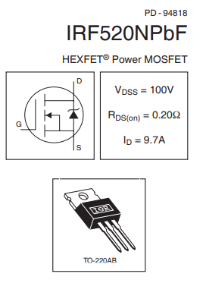
DATA COLLECTION (MOSFET)
Data was obtained from NASA's prognostics and aging experiments on MOSFETs. (Source: NASA)
Experiment Setup:
Power MOSFET: IRF520NPbF
Gate Voltage: 15V
Frequency: 1kHz
Duty Cycle: 40%
Drain Source Bias: 4V
Resistive Load: 0.2 Ω
Sampling Frequency: 0.4mS
~3000 transient measurements for every 35 minutes of aging
Data size: ~9 GB (Multiple MATLAB files)
Figure 2: MOSFET Datasheet

Slide 7
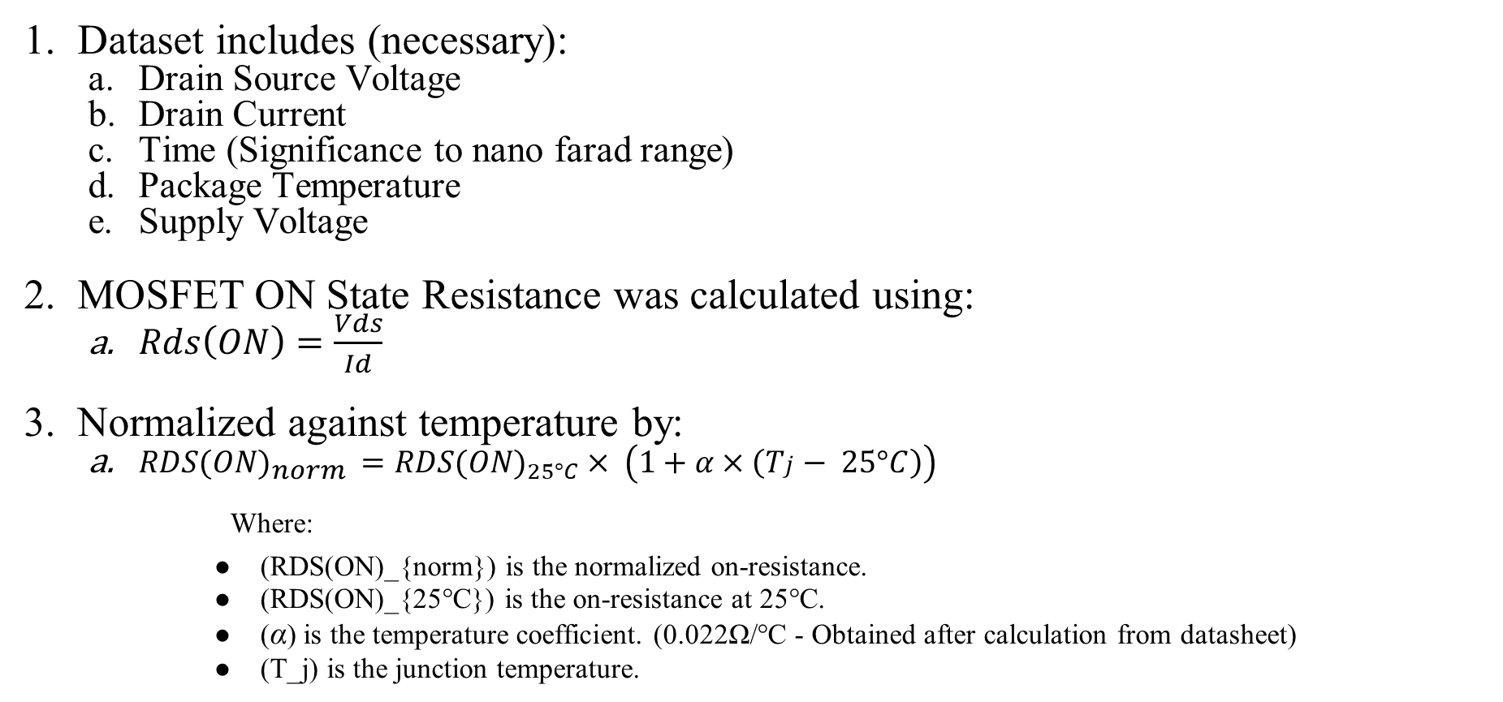
DATA COLLECTION (MOSFET)
Dataset includes (necessary):
Drain Source Voltage
Drain Current
Time (Significance to nano farad range)
Package Temperature
Supply Voltage
MOSFET ON State Resistance was calculated using:
$Rds\left(ON\right)=\frac{Vds}{Id}$
Normalized against temperature by:
${RDS(ON)}_{norm} ={RDS(ON)}_{25°C}× \left(1+α×\left(Tj − 25°C\right)\right)$
Where:
(RDS(ON)_{norm}) is the normalized on-resistance.
(RDS(ON)_{25°C}) is the on-resistance at 25°C.
(α) is the temperature coefficient. (0.022Ω/°C - Obtained after calculation from datasheet)
(T_j) is the junction temperature.

Slide 8
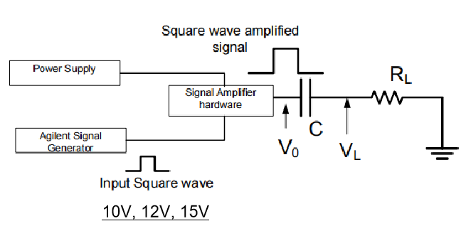
DATA COLLECTION (CAPACITOR)
The Electrochemical Impedance Spectrum (EIS) data came from an actual continuous experiment implemented by NASA, which can help people know, model, or train and predict the actual degradation process.
Experiment Setup:
Nominal capacitance: 2200µF
Normal working voltage: 5V
Voltage applied: 10V, 12V, 14V
Experiment duration: longer than 5000 hours
3. Data size: ~4.5 GB
4. Dataset includes:
Frequency response data of capacitor
Testing time
Voltage applied
Figure 3: Capacitor test condition

Slide 9
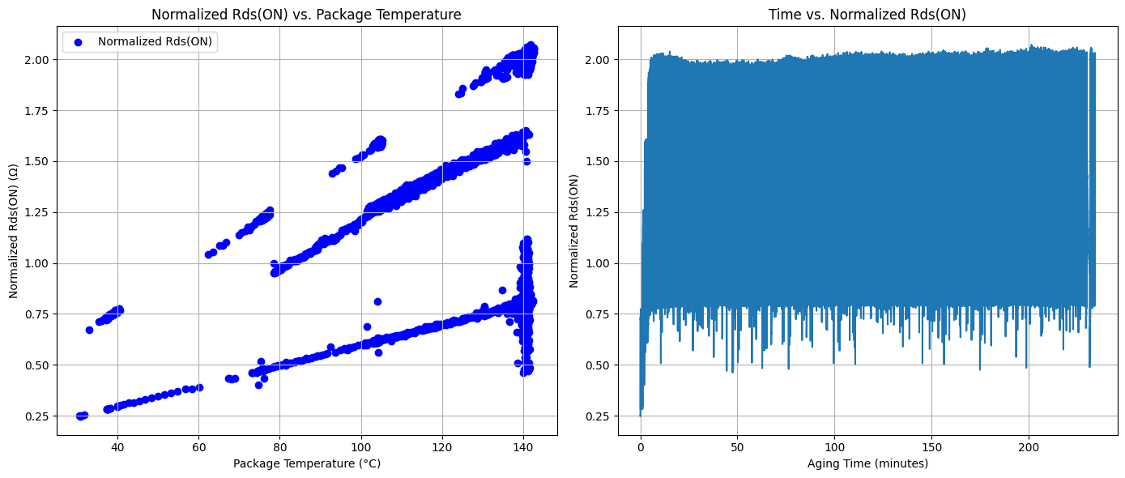
DATA ANALYSIS (MOSFET)
Downloaded, extracted and plotted the raw data (Collab and MATLAB)
Calculated:
Normalized_Rds
Obtained the plot for raw data
OBSERVATION:
Measuring instruments precision is questionable for sampling rate
Rds is characterized by aging time and temperature both.
Figure 4: MOSFET Raw data visualization (Test 10 run 7)

Slide 10
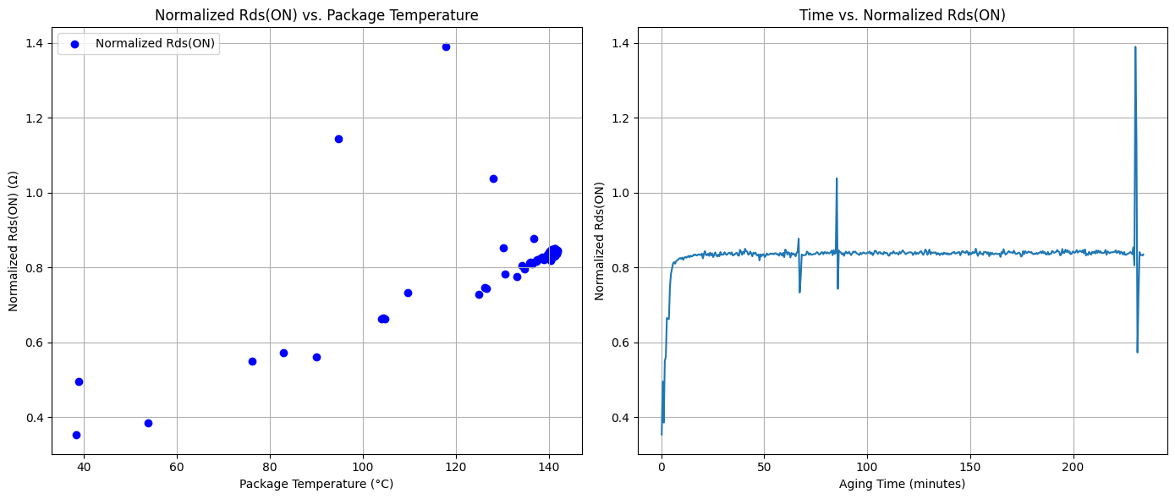
DATA ANALYSIS (MOSFET)
Data Cleaning
Sampled the data for every 0.5 min.
Every 30 sec data is averaged
Observation:
Clean Data
Can be utilized for further data investigation
3. Utilized the above cleaning strategy for all the datasets.
Different dataset:
Same MOSFET (type) but different aging environment condition.
Figure 5: MOSFET Cleaned data visualization (Test 10 run 7)

Slide 11
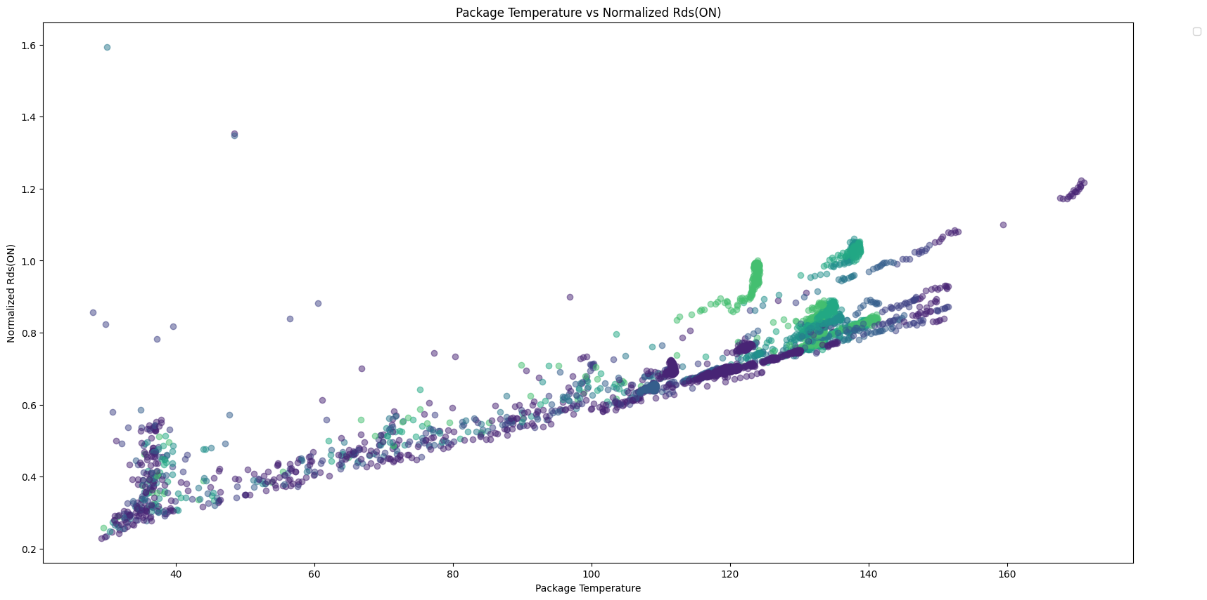
DATA ANALYSIS (MOSFET)
Cumulative plot to realize the aging character of MOSFET
Rds increases with increasing temperature and time
Increase in Rds = Power loss
Observation:
Identification of trends and patterns in the data
Completion of Exploratory Data Analysis (EDA)
Potential to perform modeling and predicting the behavior of systems that change over time i.e. Perform Time Series Analysis
Figure 6: Cumulative Rds Complete data visualization

Slide 12
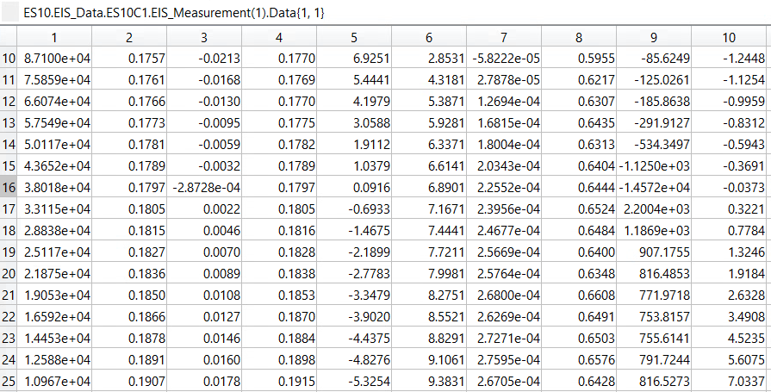
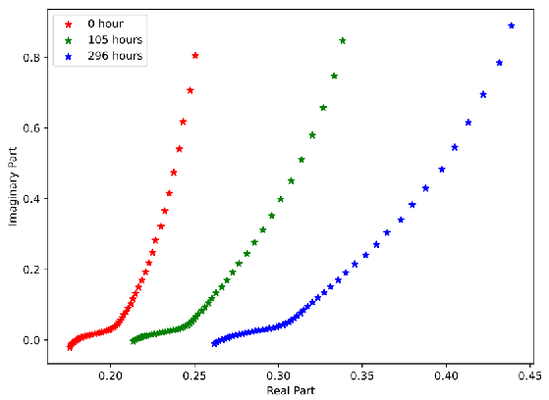
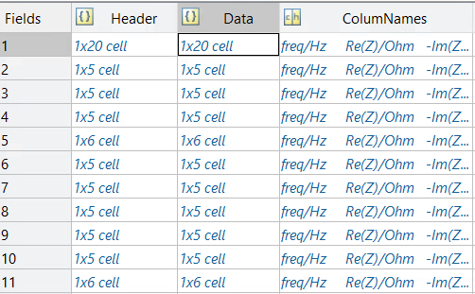
DATA ANALYSIS (Capacitor)
Downloaded and extracted the raw EIS data.
2. Plotted the raw EIS data.
Figure 7: Capacitor disorganized data pattern in MATLAB
Figure 8: Raw ESR’s data visualization

Slide 13
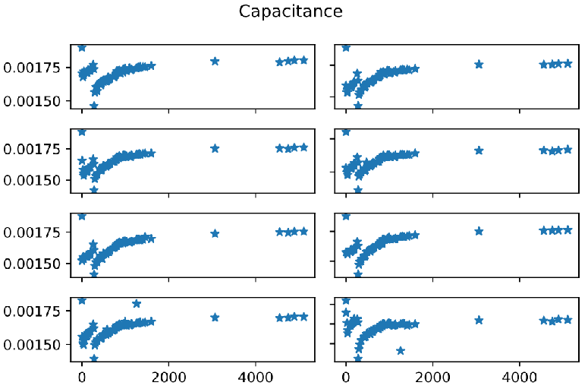
DATA ANALYSIS (Capacitor)
Establish equivalent circuit model to generate capacitance and resistance data. (using curve_fit function in scipy).
8 capacitors
73 different testing time
3 voltage levels
4. Plotted the raw capacitance data.
5. OBSERVATION:
Degradation occurred along with time before 300 hours. Then there’s a seeming “recovery” after that, which doesn’t make sense and is deemed that some interior physical change occurred.
Capacitance is characterized by aging time and applied voltage.
6. Data Cleaning: resampled the data, retained the data before 300 hours.
Figure 9: Capacitor Complete data visualization

Slide 14
MODEL DEVELOPMENT (MOSFET)
A Long Short-Term Memory (LSTM) neural network was used to model the time series data.
LSTM networks are a type of recurrent neural network (RNN) that are well-suited for modeling time series data with long-range dependencies.
Decision based on:
Efficiently Handles Long-Range Dependencies: LSTMs can learn complex relationships between past and future values in time series data, crucial for accurate RUL prediction.
Adaptability: LSTMs can adapt to non-linear and dynamic data patterns, commonly observed in power electronics degradation processes.
High Performance: LSTMs have achieved state-of-the-art results in various RUL prediction tasks compared to other machine learning models.
Speed performance for obtaining a data fit

Slide 15
MODEL DEVELOPMENT (MOSFET)
Model Architecture Design:
LSTM Layer: Employed a single LSTM layer with 35 neurons to capture temporal dependencies in the data.
Activation Function: Used the rectified linear unit (ReLU) activation function for its non-linearity and efficient training.
Dropout Layer: Incorporated a dropout layer with a dropout rate of 0.38 to prevent overfitting and improve generalization.
Hyperparameter Tuning:
Optimizer: Selected the Adam optimizer for its efficiency and adaptive learning rate adjustments.
Loss Function: Used the mean squared error (MSE) loss function as it measures the average squared difference between predicted and actual RUL values.
Model Training:
Training Data: Trained the model on 80% of the preprocessed data, allowing it to learn the patterns and relationships in the data.
Validation Data: Used 20% of the preprocessed data as validation data to monitor the model's performance during training and prevent overfitting.
Batch Size: Employed a batch size of 32 to balance training efficiency and generalization.
Epochs: Trained the model for 100 epochs, allowing it to learn effectively without overfitting.
Model Evaluation:
R2 Score: Achieved an R2 score of 0.7915, indicating that the model explains 79.15% of the variance in the RUL predictions.
Mean Squared Error (MSE): Obtained an MSE of 0.0344, demonstrating the model's ability to make accurate RUL predictions.

Slide 16
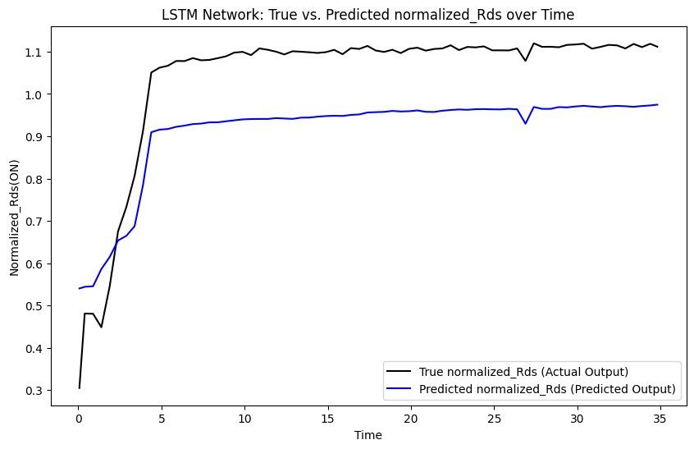
MODEL RESULT
Model tuned for complete dataset.
Dissatisfactory performance for specific case scenarios.
Figure 10: LSTM Network (True vs Predicted)

Slide 17
MODEL DEVELOPMENT (MOSFET)
Model Retraining - Applied Incremental Learning
The model was retrained in an incremental learning fashion to adapt to new data as it becomes available.
Incremental learning allows the model to continuously improve its performance without requiring retraining on the entire dataset.
Notes:
Power electronics components are constantly evolving, and their failure mechanisms can change over time. As a result, a static predictive maintenance model trained on historical data may not be able to accurately predict the RUL of components under current conditions.
Incremental learning addresses this challenge by allowing the model to continuously adapt to new data as it becomes available. This ensures that the model remains up-to-date with the latest trends and patterns in the data, leading to more accurate RUL predictions.

Slide 18
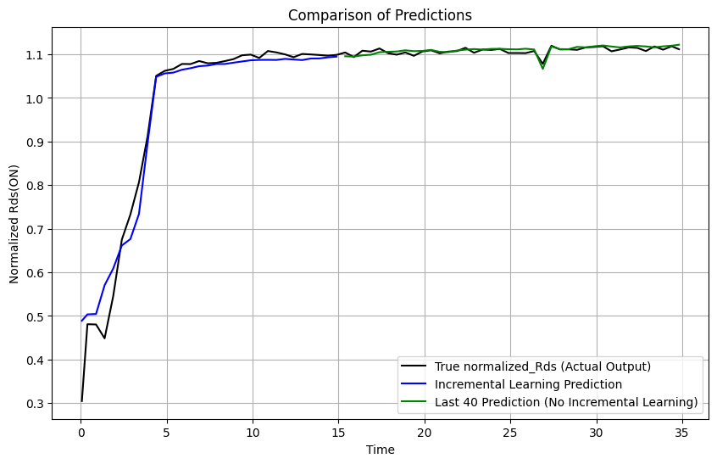
MODEL RESULT AND VALIDATION
Benefits of Incremental Learning:
Improved Accuracy: Incremental learning helps the model adapt to changes in the data over time, leading to more accurate RUL predictions.
Reduced Computational Cost: Retraining the entire model on new data can be computationally expensive. Incremental learning only updates the model with the new data, reducing the computational burden.
Real-Time Updates: Incremental learning allows the model to be updated in real-time as new data becomes available, ensuring that the predictions are always based on the most recent information.
Figure 11: Incremental Learning on predeveloped LSTM model for MOSFET data

Slide 19
MODEL DEVELOPMENT(Capacitor)
Model selection: due to the smaller scale of dataset and the non-linear form of the curve, Gaussian Progress Regression(GPR) is selected as a suitable model to learn the dataset.
Model Training:
Training Data: Trained the model on 2/3 of the resampled data.
Validation Data: Used both the rest 1/3 and the whole set of the preprocessed data of the 3 voltage levels for validation.
Kernel: RBF + WhiteKernel.
Model Evaluation:
R2 Score: Achieved an R2 score of 0.563.
Mean Squared Error (MSE): Obtained an MSE of 0.018.

Slide 20
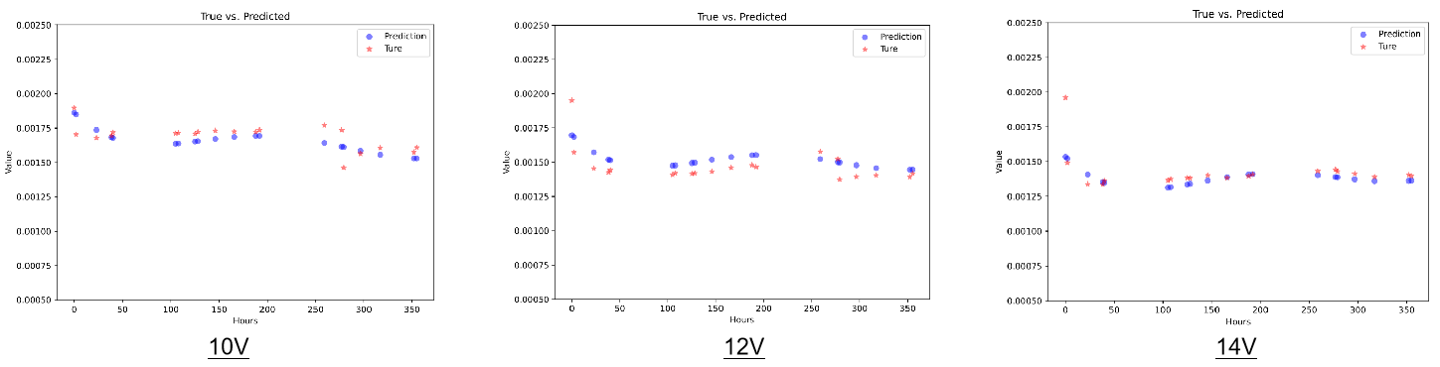
MODEL RESULT AND VALIDATION
Challenges:
1. The dataset is under overvoltage conditions, which is possibly not helpful to estimate the degradation process of the capacitor under normal working conditions. Data under normal conditions will add great value to the model and the prediction of URL.
2. It doesn’t make sense for the seeming “recovery” of capacitance. We have seen papers discussing the possible physical changes in the interior structure, making the basic R-C circuit assumption not reasonable for this phase. So we only analyzed the data before that happened.
Figure 12: GPR Model training results on Capacitor data (True vs Predicted result comparison)
Source: Analysis of Electrolytic Capacitor Degradation under Electrical Overstress for Prognostic Studies, 2015

Slide 21
CONCLUSION
LSTM NNs:
LSTM NNs effectively captured the temporal dependencies in the MOSFET data, achieving an R2 score(coefficient of determination) of 0.7915 and a low MSE of 0.0344.
GPR:
GPR provided accurate RUL predictions for capacitors, demonstrating its ability to model non-linear relationships in the data.
R2 score of 0.563 and MSE of 0.018.
Implications for Predictive Maintenance:
Proactive Maintenance: The developed models enable proactive maintenance by predicting RUL before components fail, preventing unplanned downtime and extending their lifespan.
Reduced Maintenance Costs: By optimizing maintenance schedules and reducing unplanned downtime, predictive maintenance can significantly reduce maintenance costs.
Improved System Reliability: Accurate RUL predictions contribute to enhanced system reliability and safety by preventing catastrophic failures.

Slide 22
FUTURE WORKS
Integration of the Trained models into a DSP:
Embedded System Development: Develop a robust embedded system that seamlessly integrates the trained models into the DSP hardware.
Resource Optimization: Optimize the models architecture and algorithms to minimize computational complexity and resource utilization on the DSP platform.
Real-Time Performance: Ensure real-time data processing and RUL prediction capabilities to meet the demands of critical industrial systems.
Incremental Learning within the DSP Environment
Adaptive Model Updates: Implement incremental learning algorithms within the DSP to continuously update the NN model based on new data streams.

Slide 23
FUTURE WORKS
Examples of Critical Industrial Systems where predictive maintenance of power electronics shall be crucial:
Aerospace Systems: Avionics, propulsion systems, and electrical power systems in aircraft and spacecraft.
Energy Systems: Power grids, wind turbines, and solar energy systems.
Industrial Automation: Manufacturing plants, process control systems, and robotics.
Transportation Systems: Rail locomotives, electric vehicles, and maritime vessels.

Slide 24
REFERENCES
Analysis of Electrolytic Capacitor Degradation under Electrical Overstress for Prognostic Studies, ANNUAL CONFERENCE OF THE PROGNOSTICS AND HEALTH MANAGEMENT SOCIETY, 2015
Prognostic techniques for capacitor degradation and health monitoring, The Maintenance & Reliability Conference, MARCON, 2011
Integrated diagnostic prognostic experimental setup for capacitor degradation and health monitoring, IEEE AUTOTESTCON, 2010
Celaya, José R., et al. "Prognostics approach for power MOSFET under thermal-stress aging." 2012 Proceedings Annual Reliability and Maintainability Symposium. IEEE, 2012.
Celaya, Jose R., et al. "Towards prognostics of power MOSFETs: Accelerated aging and precursors of failure." Annual Conference of the PHM Society. Vol. 2. No. 1. 2010.
Infineon Technologies. (2019, February). IRF520NPbF. https://www.infineon.com/dgdl/irf520npbf.pdf?fileId=5546d462533600a4015355e340711985

Slide 25
“Data is the new oil in the digital economy, and analytics is the combustion engine.”

Slide 26
CONTRIBUTIONS: Biplov Jha (60%) Lin Dong (40%)

Slide 27
THANK YOU

